Slide 1
JSP
JSP technology is used to create web application just like Servlet technology. It can be thought of as an extension to servlet because it provides more functionality than servlet such as expression language, jstl etc.
A JSP page consists of HTML tags and JSP tags. The jsp pages are easier to maintain than servlet because we can separate designing and development. It provides some additional features such as Expression Language, Custom Tag etc.
It focuses more on presentation logic of the web application. JSP pages are easier to maintain then a Servlet. JSP pages are opposite of Servlet. Servlet adds HTML code inside Java code while JSP adds Java code inside HTML. Everything a Servlet can do, a JSP page can also do it.
JSP enables us to write HTML pages containing tags that run powerful Java programs. JSP separates presentation and business logic as Web designer can design and update JSP pages without learning the Java language and Java Developer can also write code without concerning the web design.

Slide 2
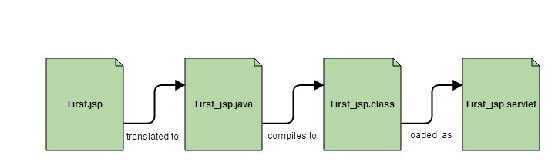
In the end a JSP becomes a Servlet
JSP pages are converted into Servlet by the Web Container. The Container translates a JSP page into servlet class source(.java) file and then compiles into a Java Servlet class.

Slide 3
Advantage of JSP over Servlet
There are many advantages of JSP over servlet. They are as follows:
1) Extension to Servlet
JSP technology is the extension to servlet technology. We can use all the features of servlet in JSP. In addition to, we can use implicit objects, predefined tags, expression language and Custom tags in JSP, that makes JSP development easy.
2) Easy to maintain
JSP can be easily managed because we can easily separate our business logic with presentation logic. In servlet technology, we mix our business logic with the presentation logic.
3) Fast Development: No need to recompile and redeploy
If JSP page is modified, we don't need to recompile and redeploy the project. The servlet code needs to be updated and recompiled if we have to change the look and feel of the application.
4) Less code than Servlet
In JSP, we can use a lot of tags such as action tags, jstl, custom tags etc. that reduces the code. Moreover, we can use EL, implicit objects etc.

Slide 4
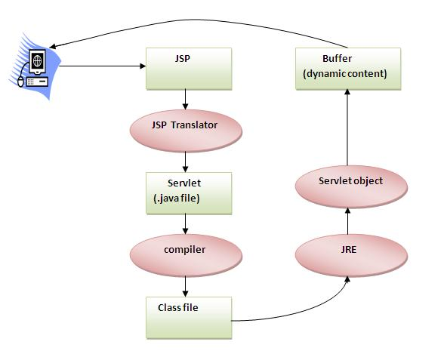
Lifecycle of JSP

Slide 5
Lifecycle of JSP
A JSP page is converted into Servlet in order to service requests. The translation of a JSP page to a Servlet is called Lif ecycle of JSP. JSP Lifecycle consists of following steps.
1.Translation of JSP to Servlet code.
2.Compilation of Servlet to bytecode.
3.Loading Servlet class.
4.Creating servlet instance.
5.Initialization by calling jspInit() method
6.Request Processing by calling _jspService() method
7.Destroying by calling jspDestroy() method

Slide 6
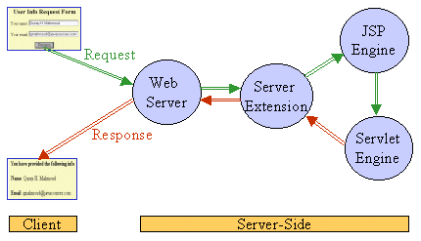
JSP Processing

Slide 7
JSP Processing
The below steps that are required to process JSP Page –
1.Web browser sends an HTTP request to the web server requesting JSP page.
2.Web server recognizes that the HTTP request by web browser is for JSP page by checking the extension of the file (i.e .jsp)
3.Web server forwards HTTP Request to JSP engine.
4.JSP engine loads the JSP page from disk and converts it into a servlet
5.JSP engine then compiles the servlet into an executable class and forward original request to a servlet engine.
6.Servlet engine loads and executes the Servlet class.

Slide 8
JSP Processing
7. Servlet produces an output in HTML format
8. Output produced by servlet engine is then passes to the web server inside an HTTP response.
9. Web server sends the HTTP response to Web browser in the form of static HTML content.
10. Web browser loads the static page into the browser and thus user can view the dynamically generated page.

Slide 9
JSP Page Anatomy
A JSP page is made up of template data and/or syntactic elements, each of which can be composed of various components as:
HTML
XML
Text
Expression Language
Scriplet Tags & Custom Tags
Directives
Java Beans and etc…

Slide 10
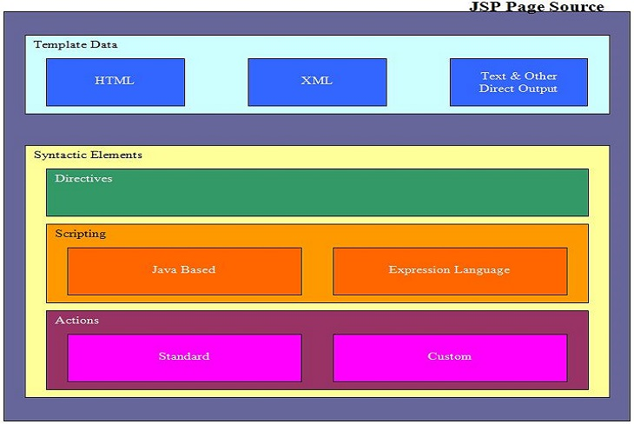
JSP Page Anatomy
Various components of jsp page is illustrated by the following diagram.

Slide 11
JSP Scriptlet tag (Scripting elements)
In JSP, java code can be written inside the jsp page using the scriptlet tag. Let's see what are the scripting elements first.JSP Scripting elements
The scripting elements provides the ability to insert java code inside the jsp. There are three types of scripting elements:
scriptlet tag
expression tag
declaration tag

Slide 12
JSP scriptlet tag
A scriptlet tag is used to execute java source code in JSP. Syntax is as follows:
<% java source code %>
Example of JSP scriptlet tag
In this example, we are displaying a welcome message.
<html>
<body>
<% out.print("welcome to jsp"); %>
</body>
</html>

Slide 13
JSP expression tag
The code placed within JSP expression tag is written to the output stream of the response. So you need not write out.print() to write data. It is mainly used to print the values of variable or method.
Syntax of JSP expression tag
<%= statement %>
Example of JSP expression tag
In this example of jsp expression tag, we are simply displaying a welcome message.
<html>
<body>
<%= "welcome to jsp" %>
</body>
</html>

Slide 14
JSP Declaration Tag
The JSP declaration tag is used to declare fields and methods.
The code written inside the jsp declaration tag is placed outside the service() method of auto generated servlet.
So it doesn't get memory at each request.
Syntax of JSP declaration tag
The syntax of the declaration tag is as follows:
<%! field or method declaration %>

Slide 15
Example of JSP declaration tag that declares field
In this example of JSP declaration tag, we are declaring the field and printing the value of the declared field using the jsp expression tag.
index.jsp
<html>
<body>
<%! int data=50; %>
<%= "Value of the variable is:"+data %>
</body>
</html>

Slide 16
JSP Implicit Objects
There are 9 jsp implicit objects. These objects are created by the web container that are available to all the jsp pages.
The available implicit objects are out, request, config, session, application etc.
A list of the 9 implicit objects is given below:

Slide 17
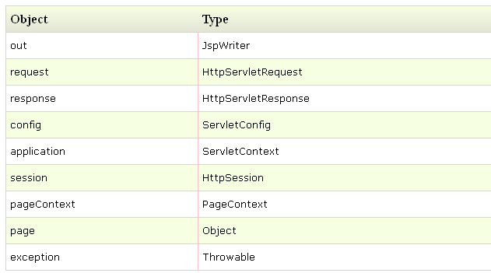
List of the 9 implicit objects

Slide 18
JSP - Expression Language (EL)
JSP Expression Language (EL) makes it possible to easily access application data stored in JavaBeans components. JSP EL allows you to create expressions both (a) arithmetic and (b) logical. Within a JSP EL expression, you can use integers, floating point numbers, strings, the built-in constants true and false for boolean values, and null.
Syntax:
Typically, when you specify an attribute value in a JSP tag, you simply use a string. For example:
<jsp:setProperty name="box" property="perimeter" value="100"/>

Slide 19
JSP - Expression Language (EL)
JSP EL allows you to specify an expression for any of these attribute values. A simple syntax for JSP EL is as follows:
${expr} Here expr specifies the expression itself. The most common operators in JSP EL are . and []. These two operators allow you to access various attributes of Java Beans and built-in JSP objects.
For example above syntax <jsp:setProperty> tag can be written with an expression like:
<jsp:setProperty name="box" property="perimeter" value="${2*box.width+2*box.height}"/> When the JSP compiler sees the ${} form in an attribute, it generates code to evaluate the expression and substitutes the value of expression.

Slide 20
JSP - Expression Language (EL)
You can also use JSP EL expressions within template text for a tag. For example, the <jsp:text> tag simply inserts its content within the body of a JSP. The following <jsp:text> declaration inserts <h1>Hello JSP!</h1> into the JSP output:
<jsp:text>
<h1>Hello JSP!</h1>
</jsp:text>

Slide 21
JSP - Expression Language (EL)
You can include a JSP EL expression in the body of a <jsp:text> tag (or any other tag) with the same ${} syntax you use for attributes. For example:
<jsp:text>
Box Perimeter is: ${2*box.width + 2*box.height}
</jsp:text>

Slide 22
JSP - Expression Language (EL)
EL expressions can use parentheses to group subexpressions. For example, ${(1 + 2) * 3} equals 9, but ${1 + (2 * 3)} equals 7.
To deactivate the evaluation of EL expressions, we specify the isELIgnored attribute of the page directive as below:
<%@ page isELIgnored ="true|false" %>
The valid values of this attribute are true and false. If it is true, EL expressions are ignored when they appear in static text or tag attributes. If it is false, EL expressions are evaluated by the container.

Slide 23
MVC in JSP
MVC stands for Model View and Controller. It is a design pattern that separates the business logic, presentation logic and data.
Controller acts as an interface between View and Model. Controller intercepts all the incoming requests.
Model represents the state of the application i.e. data. It can also have business logic.
View represents the presentation i.e. UI(User Interface).
Advantage of MVC (Model 2) Architecture
Navigation Control is centralized
Easy to maintain the large application

Slide 24
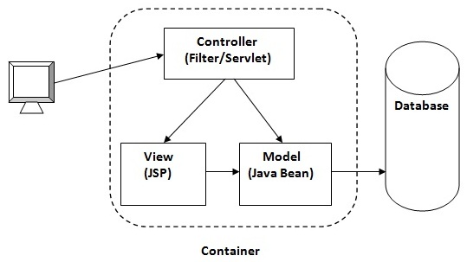
MVC in JSP

Slide 25
JSP - Exception Handling
When you are writing JSP code, a programmer may leave a coding errors which can occur at any part of the code. You can have following type of errors in your JSP code:
Checked exceptions: Achecked exception is an exception that is typically a user error or a problem that cannot be foreseen by the programmer. For example, if a file is to be opened, but the file cannot be found, an exception occurs. These exceptions cannot simply be ignored at the time of compilation.
Runtime exceptions: A runtime exception is an exception that occurs that probably could have been avoided by the programmer. As opposed to checked exceptions, runtime exceptions are ignored at the time of compliation.
Errors: These are not exceptions at all, but problems that arise beyond the control of the user or the programmer. Errors are typically ignored in your code because you can rarely do anything about an error. For example, if a stack overflow occurs, an error will arise. They are also ignored at the time of compilation.

Slide 26
JSP - Exception Handling
There are two methods in JSP to handle the exception.
1. Using Exception Object:
2. Using Try...Catch Block:
Types of Exception Handling
Using Exception Object
Using Try-Catch Block

Slide 27
Using Exception Object
The exception object is an instance of a subclass of Throw able (e.g., java.lang. NullPointerException) and is only available in error pages.
JSP gives you an option to specify Error Page for each JSP. Whenever the page throws an exception, the JSP container automatically invokes the error page.

Slide 28
Example of Exception Object
Following is an example to specifiy an error page for a main.jsp. To set up an error page, use the <%@ page errorPage="xxx" %> directive.
<%@ page errorPage="ShowError.jsp" %>
<html>
<head><title>ErrorHandlingExample</title></head>
<body>
<% // Throw an exception to invoke the error page
int x = 1;
if (x == 1)
{
throw new RuntimeException("Errorcondition!!!"); }%>
</body>
</html>

Slide 29
Error Handling JSP Page
<%@ page isErrorPage="true" %>
<html>
<head><title>Show Error Page</title>
</head>
<body><h1>Opps...</h1><p>Sorry, an error occurred.</p><p>Here is the exception stack trace: </p>
<pre><% exception.printStackTrace(response.getWriter()); %>
</pre>
</body>
</html>

Slide 30
Using Try...Catch Block:
If you want to handle errors with in the same page and want to take some action instead of firing an error page, you can make use of try....catch block.
Following is a simple example which shows how to use try...catch block. Let us put following code in main.jsp.
The Example is on next page:

Slide 31
Example of using Try-Catch Block
<html>
<head>
<title>Try...Catch Example</title>
</head>
<body>
<% try
{
int i = 1; i = i / 0;
out.println("The answer is " + i);
}
catch (Exception e)
{
out.println("An exception occurred: " + e.getMessage()); }%>
</body>
</html>
Now try to access main.jsp, it should generate something as follows:
An exception occurred: / by zero

Slide 32
Thanks

